Slide 1
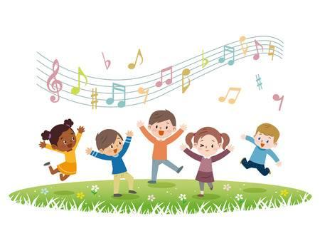
Back to School Night 2022-2023
General Music and GT Music
Elsa Slater, Collins Elementary School
eslater@livingston.org

Slide 2
K-5 General Music Classes
Classes are 43 minutes and meet once weekly
All students participate in this class
The main goal of the program is to provide students with a background in singing, playing instruments, reading and writing music, music history and appreciation to foster a lifelong connection to the arts.

Slide 3
My Philosophy of Music Education
Music classes should be joyful, playful and active.
Participation is essential to build good musicianship; music is NOT a spectator sport!
Skills are developed sequentially: beat before rhythm, vocal exploration/play as a means to develop in-tune singing.
Students experience a variety of activities during any given class: moving, singing, listening, reading and writing musical notation, creating, reflecting.
Multifaceted approach that draws from a variety of methodologies: Orff, Kodaly, Dalcroze.

Slide 4
Why is General Music essential for your child?
This is where we build LIFELONG skills that benefit your child - being able to sing in tune, keep a beat, appreciate what goes into creating music or performing it for others!
Establishing a background in music fundamentals as a child (keeping the beat, singing in tune, moving and responding to music), makes it that much easier to excel in future instrumental or vocal study.
Having confidence in oneself to be musical is such a great benefit throughout one’s life: singing to someone on their birthday, or dancing at a special event. It’s hard to be someone who is afraid to sing or dance with others! This CAN be cultivated with encouragement and practice!

Slide 5
Music Program Activities - a Sample List:
Kindergarten: Understanding loud and quiet
Open hands during loud/close during quiet portion of “Autumn” from Vivaldi’s Four Seasons.
Follow the leader by playing rhythm sticks loudly and quietly to classmate’s cues.
Grade One: Expanding vocal range and singing in tune
Follow a koosh ball tossed into air with voice.
Choose a bubble from a bubble wand to follow with voice until it pops!
Echo sing a melodic pattern back to a puppet.
Grade Two: Demonstrating the difference between beat and word rhythm
While singing a known song, pat the beat or clap the rhythm when a signal is given, switching at unpredictable times when cued.

Slide 6
Music Program Activities Sample List (continued)
Grade Three: Demonstrating understanding of ABA form
Create a same-different-same dance to “Gigue” from Handel’s Water Music Suite.
Expand understanding of the concept by creating a “musical sandwich.”
Grade Four: Expanding ability to sing and play independent parts
Sing a 4 part round first in large groups, then sing a given part independently near others singing a different part.
Transform same part into rhythmic round.
Grade Five: Demonstrating understanding of meter
Bounce ball on first beat of measure
Design and perform a ball bouncing sequence in a variety of meters (duple, triple, compound, odd, etc.)

Slide 7
GT Music
GT Music meets on Friday mornings. It is a 2 year program that further develops creativity and musical thinking. Participants must test into the program.

Slide 8
Communication is key:
Please don’t hesitate to reach out if you have any questions about the program. If your child is having difficulty understanding a concept or building skills, please don’t wait to reach out! I am always available to help!
Thank you for your support of our program!

Slide 9
Questions?
Please feel free to contact me at eslater@livingston.org.

